Slide 1

Indexed file Allocation Method
Nishant Kumar Giri
AC-1254

Slide 2
Points to know before studying Indexed File Allocation Method
Why
File Allocation
Types
Brief Explanation
File Allocation Methods
Advantages and Disadvantages
File Allocation Methods
File Allocation Methods
(other than Indexed)
(other than Indexed)

Slide 3
What is file Allocation? Why do we use them?

Slide 4
The allocation method defines how the files are stored in the disk blocks. Generally, files are stored on a same disk. The main problem that occurs in the operating system is that how we allocate the spaces to these files so that the utilization of disk is efficient and the quick access to the file is possible.

Slide 5
Different File allocation methods

Slide 6
1. Contiguous Allocation 2. Linked Allocation 3. Indexed Allocation

Slide 7
Contiguous Allocation

Slide 8
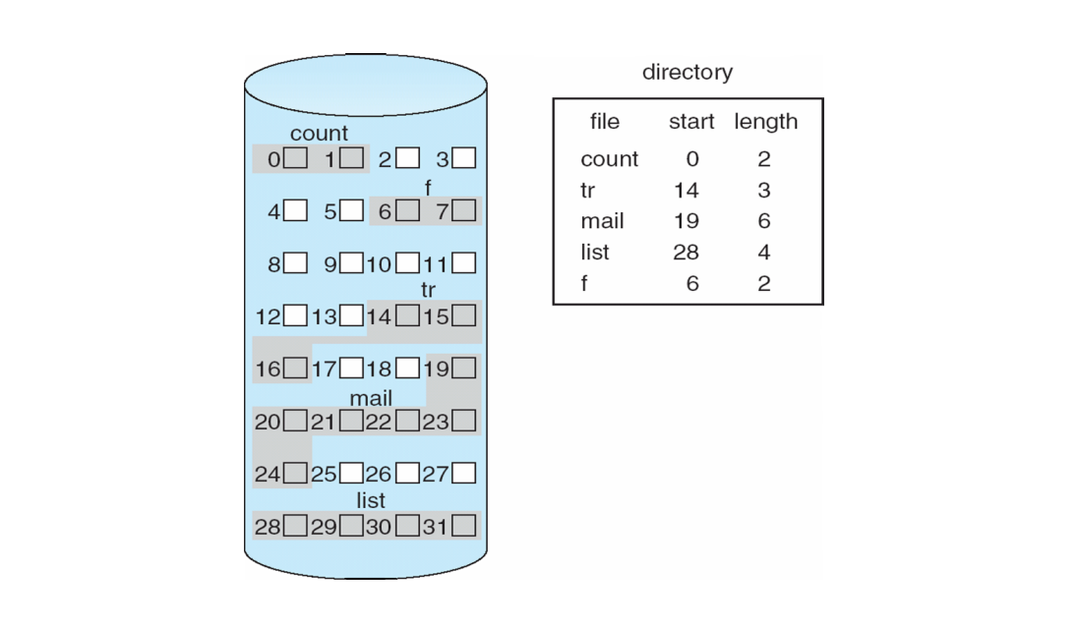

Slide 9
Advantages
The contiguous allocation method gives excellent read performance.
Contiguous allocation is easy to implement.
The contiguous allocation method supports both types of file access methods that are sequential access and direct access.
The Contiguous allocation method is fast because, in this method number of seeks is less due to the contiguous allocation of file blocks.

Slide 10
Disadvantages
In the contiguous allocation method, sometimes disk can be fragmented.
In this method, it is difficult to increase the size of the file due to the availability of the contiguous memory block.

Slide 11
Linked allocation

Slide 12
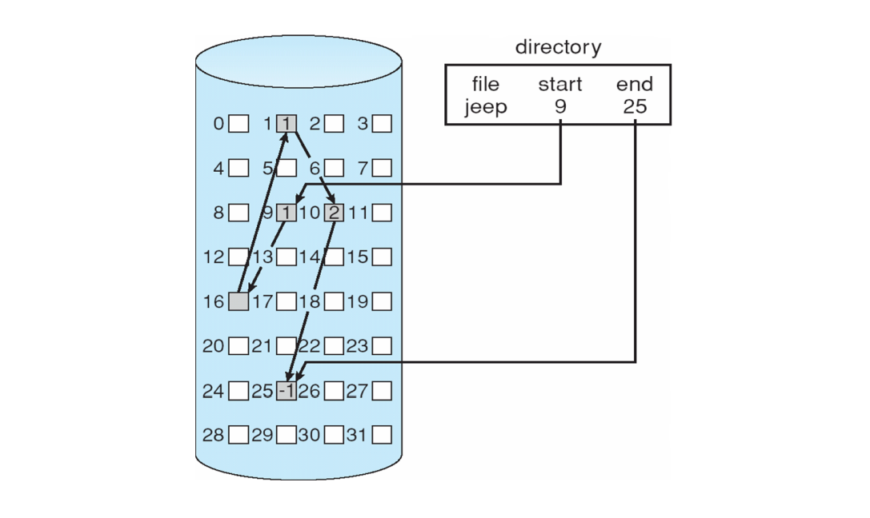

Slide 13
Advantages
In liked allocation, there is no external fragmentation. Due to this, we can utilize the memory better.
In linked allocation, a directory entry only comprises of the starting block address.
The linked allocation method is flexible because we can quickly increase the size of the file because, in this to allocate a file, we do not require a chunk of memory in a contiguous form.

Slide 14
Disadvantages
Linked list allocation does not support direct access or random access.
In linked list allocation, we need to traverse each block.
If the pointer in the linked list break in linked list allocation, then the file gets corrupted.
In the disk block for the pointer, it needs some extra space.

Slide 15
Indexed allocation

Slide 16
In this scheme, a special block known as the index block contains the pointer to all the blocks occupied by a file. each file contains its index which is in the form of an array of disk block addresses. The i-th entry of index block point to the i-th block of the file. The address of the index block is maintained by the directory. When we create a file, all pointer is set to nil. A block is obtained from the free space manager when the first i-th block is written.

Slide 17
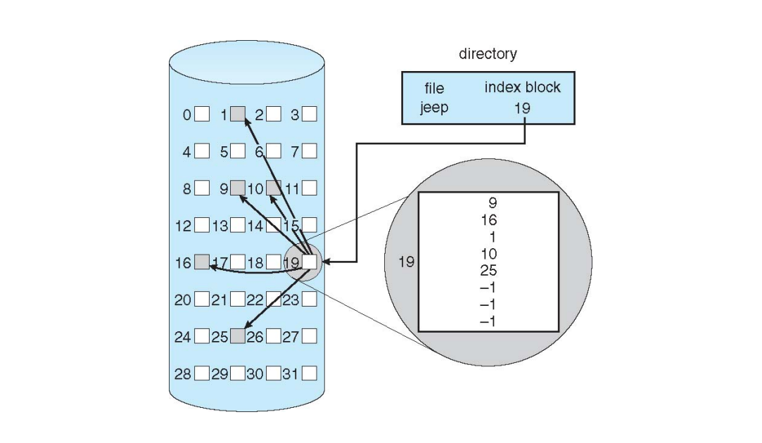

Slide 18
Advantages
This scheme supports random access of the file.
This scheme provides fast access to the file blocks.
This scheme is free from the problem of external fragmentation.

Slide 19
Disadvantages
The pointer head is relatively greater than the linked allocation of the file.
Indexed allocation suffers from the wasted space.
For the large size file, it is very difficult for single index block to hold all the pointers.
For very small files say files that expend only 2-3 blocks the indexed allocation would keep on the entire block for the pointers which is insufficient in terms of memory utilization.

Slide 20
problem

Slide 21
A single index block cannot hold all the pointer for files with large sizes.

Slide 22
solution

Slide 23
To resolve this problem, there are various mechanism which we can use:
Linked scheme
Multilevel Index
Combined Scheme

Slide 24
Linked Scheme
In the linked scheme, to hold the pointer, two or more than two index blocks are linked together. Each block contains the address of the next index block or a pointer.

Slide 25
Multilevel Index
In the multilevel index, to point the second-level index block, we use a first-level index block that in turn points to the blocks of the disk, occupied by the file. We can extend this up to 3 or more than 3 levels depending on the maximum size of the file.

Slide 26
Combined Scheme
In a combined scheme, there is a special block which is called an information node (Inode). The inode comprises of all the information related to the file like authority, name, size, etc. To store the disk block addresses that contain the actual file, the remaining space of inode is used. In inode, the starting pointer is used to point the direct blocks. This means the pointer comprises of the addresses of the disk blocks, which consist of the file data. To indicate the indirect blocks, the next few pointers are used. The indirect blocks are of three types, which are single indirect, double indirect, and triple indirect.

Slide 27
Practical aspect

Slide 28
In the UNIX operating system, every file is indexed with the help of Inode. An Inode is a block that is created at the time when the file system is designed.

Slide 29
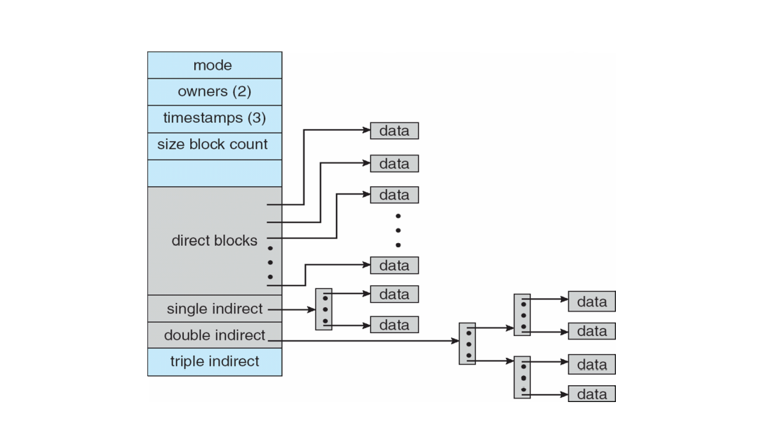

Slide 30
There are various types of information included in Inode:
Attributes of the file, such as timestamp, permissions, details, ownership, etc.
The total number of direct blocks that comprise of the pointer to the starting blocks.
In Inode, there is a single indirect pointer. It is used to point an index block. If using direct blocks, entire file cannot be indexed, then, in that case, we use a single indirect pointer.
Inode also contains a double indirect pointer. This pointer is used to point a disk block.
In Inode there is another pointer, which is a triple index pointer. This pointer is also used to point a disk block.

Slide 31
A Problem for you all

Slide 32
Write a C/C++ program to Mock Indexed Allocation Method

Slide 33
Interface
Adding a file
Deleting a file
Listing files
Seeking a particular block in a file
Printing the contents of the disk

Slide 34
solution
Thank You!

